Slide 1
Investment Strategies to Mitigate Sequence of Return Risk Sponsor: T. Rowe Price November 29th, 2018 Massachusetts Institute of Technology
Chen Fan, Ellie Liu, Haocheng Tang, Jonathan Martinez, Rachel Chen, Viktor Hermann

Slide 2
question posed
Many Defined Contribution Plan investors use a Target Date Fund as their primary investment strategy. These strategies are designed to de-risk into retirement in order to mitigate SORR. Your goal is to propose ways to improve upon glidepath strategy in order to mitigate SORR. What is the mechanism by which your proposed strategy further addresses SORR? Which approaches are most effective? In addition to an investment strategy, you will need to assume a withdrawal strategy for portfolio. The withdrawal strategy should be constant in $ amounts regardless of assumed investment strategy.

Slide 3
AGENDA
SORR – A Short Introduction
Methodology
Utility Maximization with Static Glidepaths
Utility Maximization with Dynamic Glidepaths
Conclusion

Slide 4
SORR – A Short Introduction
Methodoly
Utility Maximization with Static Glidepaths
Utility Maximization with Dynamic Glidepaths
Conclusion

Slide 5
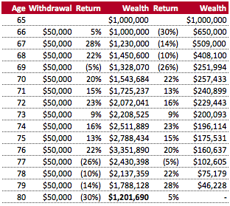
Impact of SORR
Sequence of return risk (SORR) refers to the risk an investor is exposed to due to possible changes in the order in which returns occur.
Assumptions:
Returns are same in all scenarios
Withdrawal is a fixed $ amount, not percentage of remaining balance
Distribution of wealth:
30% equity / 70% fixed income
Conclusion:
Sequence of returns matter
Bad returns in beginning over proportionately decrease wealth
SORR management paramount

Slide 6
SORR – A Short Introduction
Methodology
Utility Maximization with Static Glidepaths
Utility Maximization with Dynamic Glidepaths
Conclusion

Slide 7
steps to follow
Simulated
Return Path
Glidepaths
(Static)
Glidepaths (Dynamic)
Definition
of SORR
Maximize Utility Coverage Ratio (vs. Wealth)

Slide 8
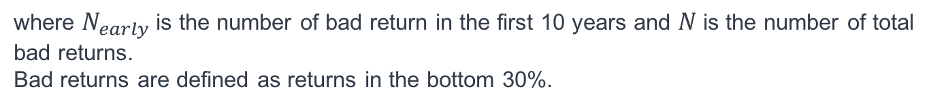
Definition of SORR
To maximize our object function, we first need to define our SORR measure. SORR has no defined metric in the literature as of now.
$$SORR= \frac{N_{early}}{N}$$
where $N_{early}$ is the number of bad return in the first 10 years and $N$ is the number of total bad returns.
Bad returns are defined as returns in the bottom 30%.
Key Observations:
SORR ranges from 0 to 1
The higher SORR, the more bad returns accumulate in the beginning
Compounded return in first 10 years explains 77% of final retirement outcome⁽¹⁾
Notes: (1) Pfau, W. D. (2013), The Lifetime Sequence of Returns: A Retirement Planning Conundrum, p. 6.

Slide 9
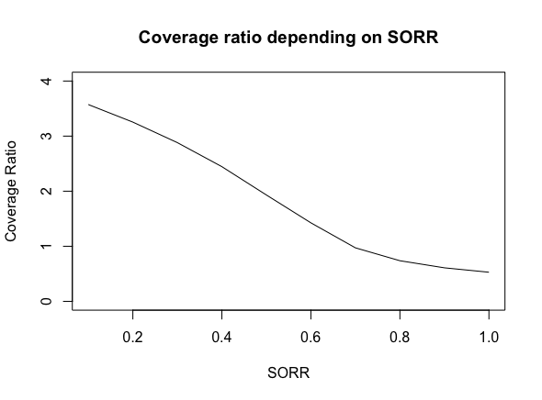
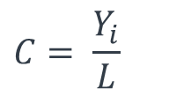
Coverage Ratio
Coverage ratio represents the portion of lifetime that our investment strategy could sustain.
(1)
$$C= \frac{Y_{i}}{L}$$
where Yi denotes the number of years covered both during and after the retirement plan and L denotes the number of years in retirement.
Notes: (1) Based on Estrada, J. & Kritzman, M. (2018), Evaluating Retirement Strategies: A Utility-Based Approach. pp. 5-6.

Slide 10
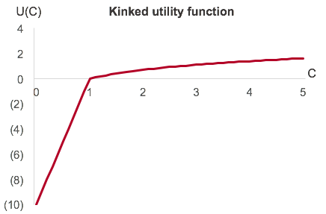
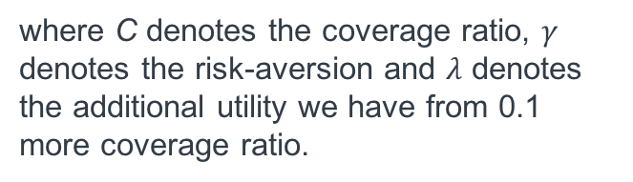
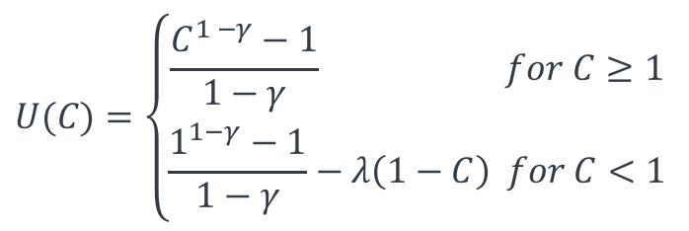
utility Coverage Ratio
Our maximization function is a kinked utility function. Our additional marginal utilitity is much higher if we do not fully cover our estimated lifetime.
(1)
$$U(C)=\left\{\begin{aligned}\frac{C^{1 −γ}−1}{1−γ} for C≥1 \\ \frac{1^{1−γ}−1}{1−γ}−λ\left(1−C\right) for C<1\end{aligned}\right.$$
where C denotes the coverage ratio, $γ$ denotes the risk-aversion and $λ$ denotes the additional utility we have from 0.1 more coverage ratio.
Notes: (1) Based on Estrada, J. & Kritzman, M. (2018), Evaluating Retirement Strategies: A Utility-Based Approach. pp. 5-6.

Slide 11
SORR – A Short Introduction
Methodology
Utility Maximization with Static Glidepaths
Utility Maximization with Dynamic Glidepaths
Conclusion

Slide 12
Approach and Assumptions
Assumptions
Choice of glidepath is static, i.e. once you choose a given asset allocation, you will not deviate from it no matter the market development⁽¹⁾
SORR is constant for projected period and can be observed ex ante
Monthly withdrawals are dollar constant over time before inflation adjustment⁽²⁾
Discretization
SORR: 0.3, 0.5, 0.7
Equity Portion: 0.1, 0.3, 0.6
Notes: (1) Current market approach. (2) Monthly withdrawals are inflation-adjusted.

Slide 13
Approach and Assumptions
Approach
Define 3 different glidepaths (conservative, moderate, aggressive) and 3 different SORR exposure (bad returns early, random, late)
Using Monte Carlo simulation, detect distribution of coverage ratio and object function
Define current income level and constant $ withdrawal
Understand rationale, sensitivity & implications of observed data

Slide 14
Income level sensitivity
Equity portion = 0.1
Notes: We quote the initial endowment from the yearly withdrawal of National Bureau of Labor Statistics $46,634/year (2014 Statistics).

Slide 15
Income level sensitivity
Equity portion = 0.3
Notes: We quote the initial endowment from the yearly withdrawal of National Bureau of Labor Statistics $46,634/year (2014 Statistics).

Slide 16
Income level sensitivity
Equity portion = 0.6
Notes: We quote the initial endowment from the yearly withdrawal of National Bureau of Labor Statistics $46,634/year (2014 Statistics).

Slide 17
Coverage ratio distribution
 |  | Glidepath
 |  | Conservative (Equity = 0.1) | Moderate (Equity = 0.3) | Aggressive (Equity = 0.6)
Timing bad return | Random (SORR = 0.3)
 | Early (SORR = 0.5)
 | Very Early (SORR = 0.7)

Slide 18
utility Coverage ratio
 |  | Glidepath
 |  | Conservative (Equity = 0.1) | Moderate (Equity = 0.3) | Aggressive (Equity = 0.6)
Timing bad return | Random (SORR = 0.3)
 | Early (SORR = 0.5)
 | Very Early (SORR = 0.7)

Slide 19
SORR – A Short Introduction
Methodology
Utility Maximization with Static Glidepaths
Utility Maximization with Dynamic Glidepaths
Conclusion

Slide 20
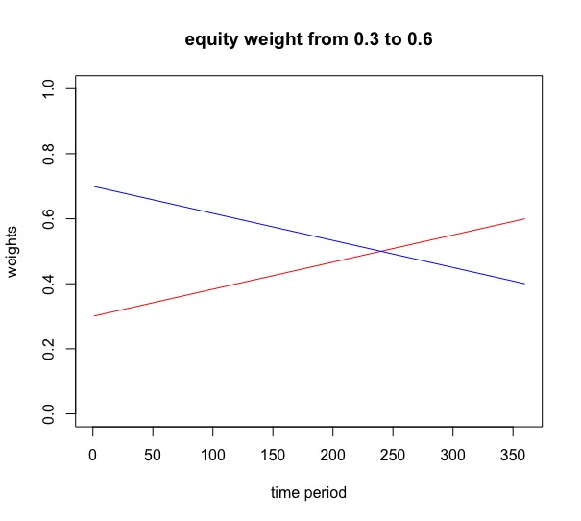
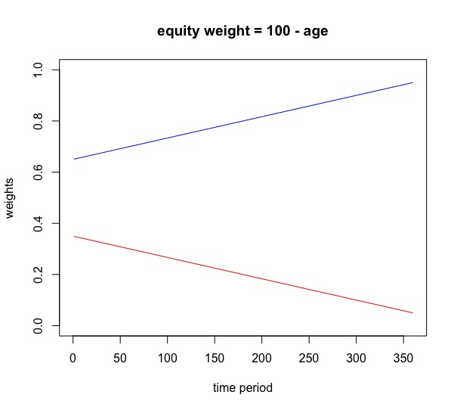
Semi-dynamic glidepath

Slide 21
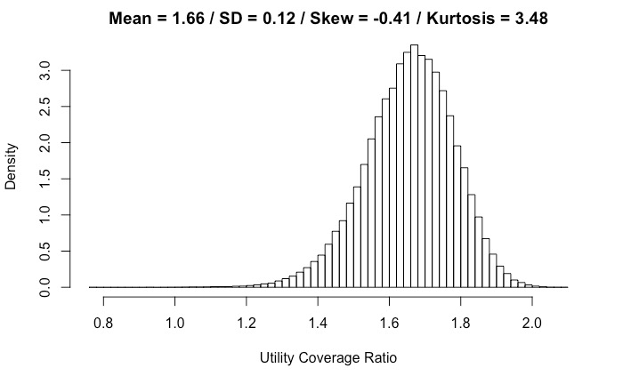
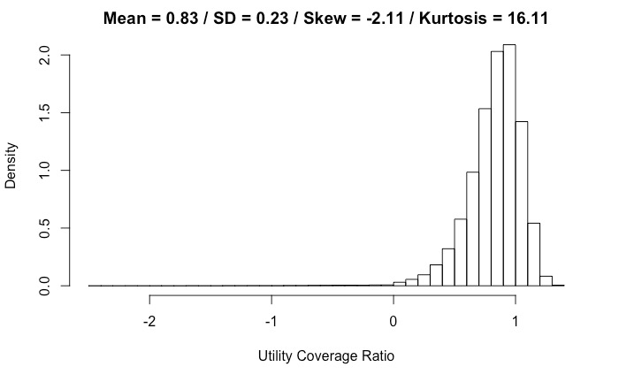
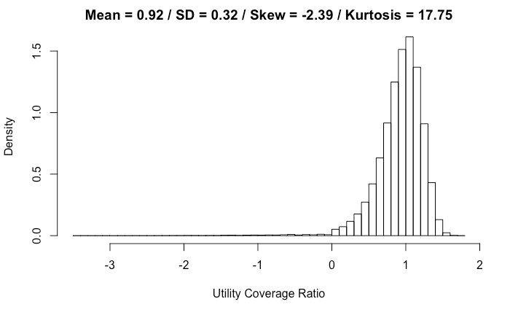
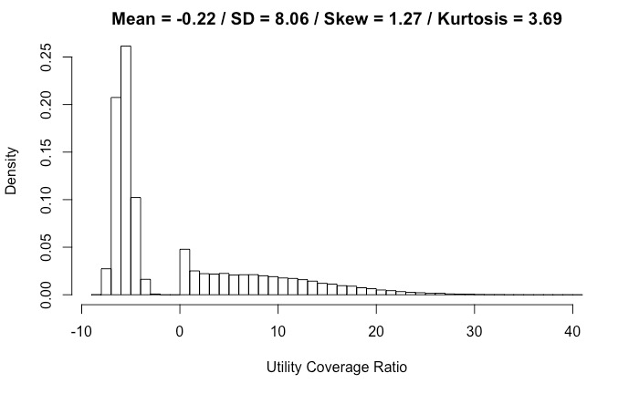
Semi-dynamic strategies
 |  | Glidepath
 |  | Equity from 0.3 to 0.6 | Equity from 0.6 to 0.3 | 100 – Age
Timing bad return | Late (SORR = 0.3)
 | Random (SORR = 0.5)
 | Early (SORR = 0.7)

Slide 22
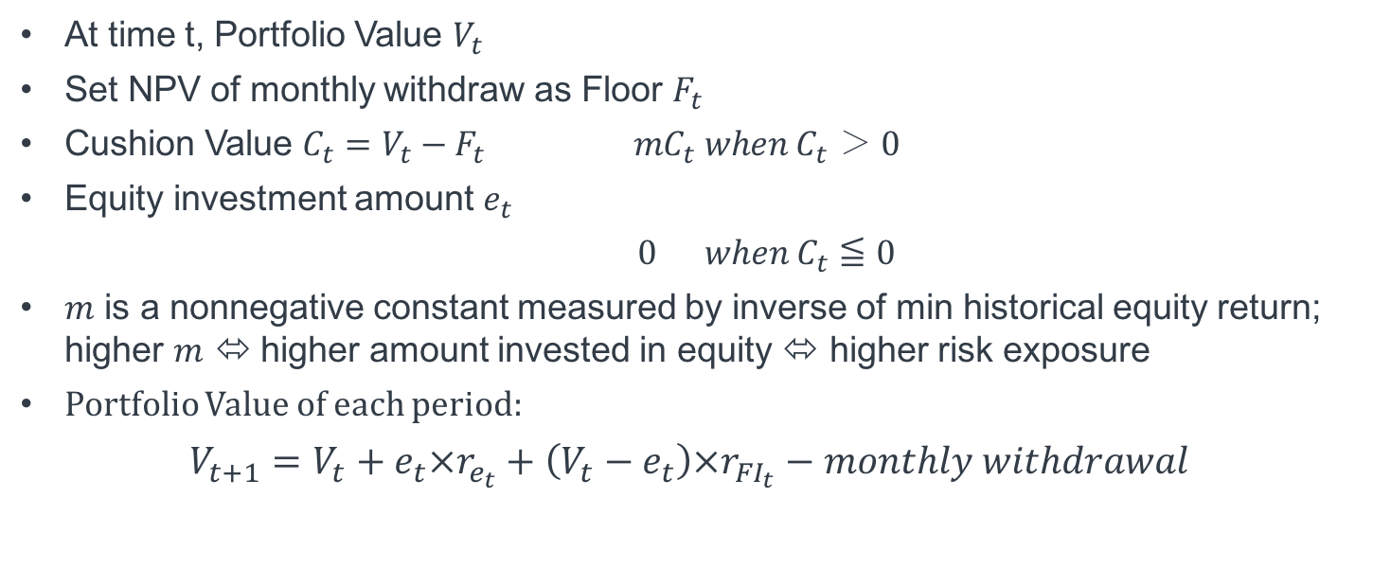
cONSTANT pROPORTION PORTFOLIO INSURANCE (CPPI)
What is CPPI?
CPPI allows an investor to maintain exposure to the upside potential of a risky asset while providing a capital guarantee against downside risk.
Approach⁽¹⁾
At time t, Portfolio Value $V_{t}$
Set NPV of monthly withdraw as Floor $F_{t}$
Cushion Value $C_{t}=V_{t}−F_{t}$ $mC_{t} when C_{t} ＞ 0$
Equity investment amount $e_{t}$
$0 when C_{t}≦0$
$m$ is a nonnegative constant measured by inverse of min historical equity return; higher $m$ ⬄ higher amount invested in equity ⬄ higher risk exposure
Portfolio Value of each period:
$$V_{t+1}=V_{t}+e_{t}×r_{e_{t}}+\left(V_{t}−e_{t}\right)×r_{{FI}_{t}}−monthly withdrawal$$
Notes: (1) Ameur, H. Ben, and J.L. Prigent. “Portfolio Insurance: Determination of a Dynamic CPPI Multiple as Function of State Variables.” Dec. 2006.

Slide 23
Constant proportion Portfolio Insurance (CPPI)
SORR = 0.3

Slide 24
Constant proportion Portfolio Insurance (CPPI)
SORR = 0.5

Slide 25
Constant proportion Portfolio Insurance (CPPI)
SORR = 0.7

Slide 26
SORR – A Short Introduction
Methodology
Utility Maximization with Static Glidepaths
Utility Maximization with Dynamic Glidepaths
Conclusion

Slide 27
Strategy Summary
SORR = 0.3
Utility Coverage Ratio | Mean | St. Dev. | Median | Skewness | Kurtosis
Constant Equity 0.1 | 0.45 | 0.24 | 0.49 | -2.47 | 16.16
Constant Equity 0.3 | 1.05 | 0.11 | 1.06 | -0.62 | 3.89
Constant Equity 0.6 | 1.45 | 0.09 | 1.62 | -0.55 | 3.75
100 - Age | -0.21 | 7.90 | -4.75 | 1.31 | 3.77
Equity 0.3 to 0.6 | 1.06 | 0.09 | 1.07 | -0.48 | 3.61
Equity 0.6 to 0.3 | 1.66 | 0.12 | 1.66 | -0.41 | 3.48
CPPI | 0.62 | 0.14 | 0.64 | -0.88 | 5.66
High
Low

Slide 28
Strategy Summary
SORR = 0.5
Utility Coverage Ratio | Mean | St. Dev. | Median | Skewness | Kurtosis
Constant Equity 0.1 | 0.13 | 0.50 | 0.26 | -2.13 | 8.30
Constant Equity 0.3 | 0.63 | 0.27 | 0.67 | -2.58 | 18.33
Constant Equity 0.6 | 1.09 | 0.28 | 1.14 | -3.02 | 27.64
100 - Age | -0.22 | 8.06 | -4.97 | 1.27 | 3.69
Equity 0.3 to 0.6 | 0.83 | 0.23 | 0.86 | -2.11 | 16.11
Equity 0.6 to 0.3 | 0.92 | 0.32 | 0.97 | -2.39 | 17.75
CPPI | 0.35 | 0.27 | 0.40 | -2.83 | 16.87
High
Low
Notes:
% decrease median: (1) 46.94%, (2) 38.53%, (3) 29.63%, (4) 4.63%, (5) 19.63%, (6) 41.57%, (7) 37.5%

Slide 29
Strategy Summary
SORR = 0.7
Utility Coverage Ratio | Mean | St. Dev. | Median | Skewness | Kurtosis
Constant Equity 0.1 | -0.45 | 0.80 | -0.17 | -0.99 | 3.23
Constant Equity 0.3 | -1.03 | 1.10 | -0.94 | -0.39 | 2.15
Constant Equity 0.6 | -2.66 | 1.51 | -2.94 | 0.58 | 2.49
100 - Age | 1.71 | 9.04 | -4.53 | 0.60 | 2.00
Equity 0.3 to 0.6 | -0.94 | 1.29 | -0.78 | -0.43 | 2.02
Equity 0.6 to 0.3 | -2.49 | 1.39 | -2.69 | 0.40 | 2.41
CPPI | -0.18 | 0.70 | 0.10 | -1.79 | 6.22
High
Low

Slide 30
Closing Remarks
SORR is an omnipresent risk factor that needs active management
After having defined a specific SORR risk, you can adjust strategy accordingly
Retirement plans have a financial goal of maintaining current living standard, any additional risk is unnecessary
Having a high equity portion in portfolio can lead to high returns, but in times of downturn you can lose a lot of wealth
Having a dynamic strategy ensures that you benefit from upsides, but can adjust to potential downturns as well

Slide 31
Thank you

Slide 32
APPENDIX

Slide 33
Justification of assumptions
Initial Value at retirement & Monthly Withdraw:
We assume the initial value to be $1 million and monthly withdraw to be $3333 before inflation adjustment, representing 4% of initial value per year throughout the period.
These are arbitrary assumptions, but as long as 4% doesn’t change, results of analysis won’t be influenced.
Takeaway:
1. Results stay the same as withdraw stays at 4%
2. If withdraw stays at 40k per year, the more initial value is, the more chance that the fund will meet commitment
3. If initial value stays at $1 million, the more monthly withdraw is, the more chance that the fund will fail to meet commitment

Slide 34
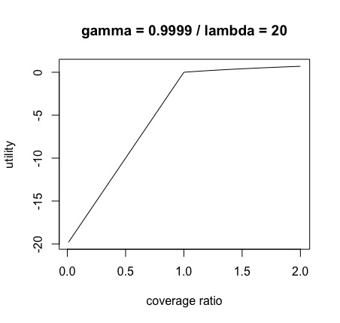
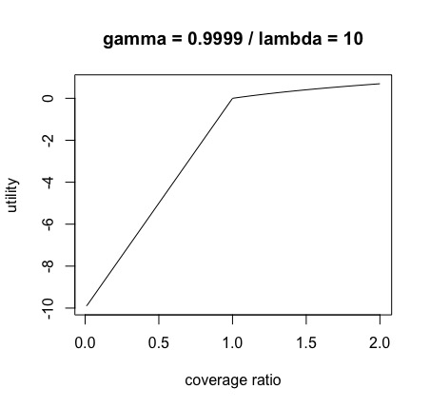
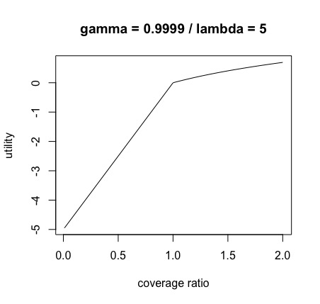
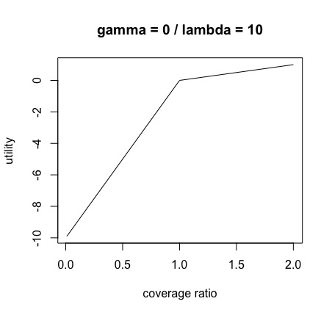
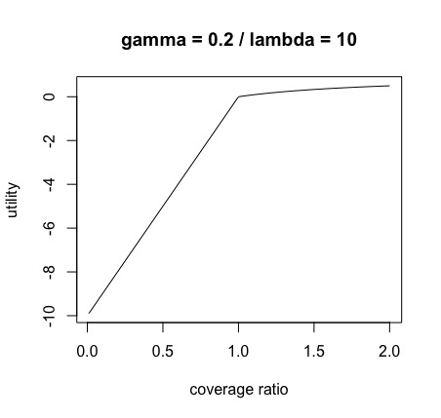
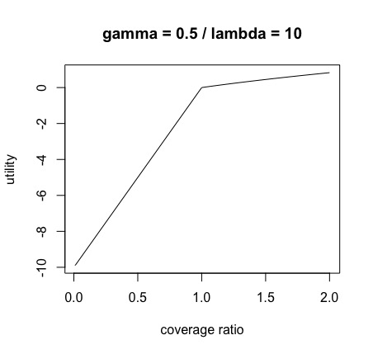
Justification of assumptions
Gamma & Lambda

Slide 35
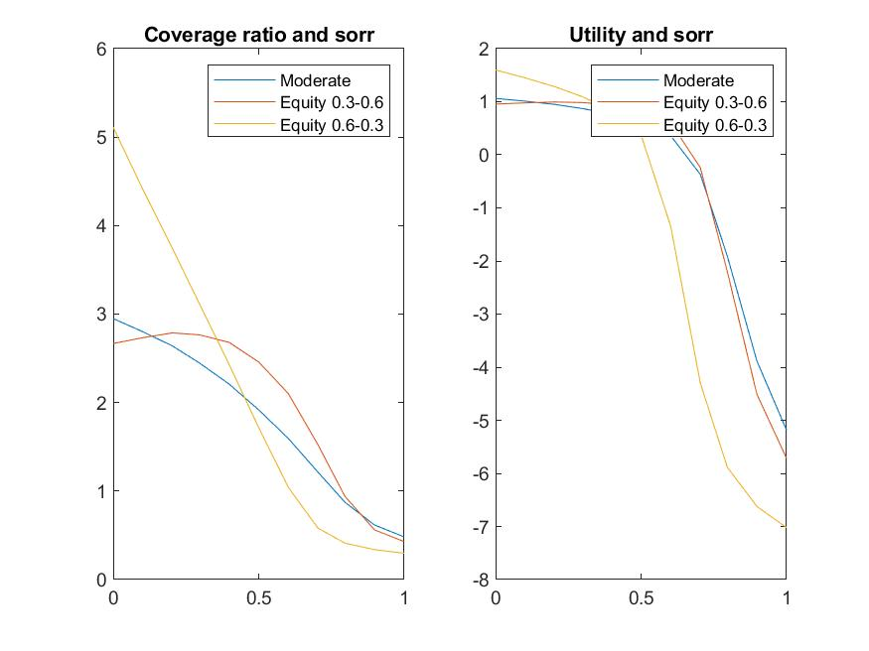
Appendix
When initial withdraw = $30,000

Slide 36
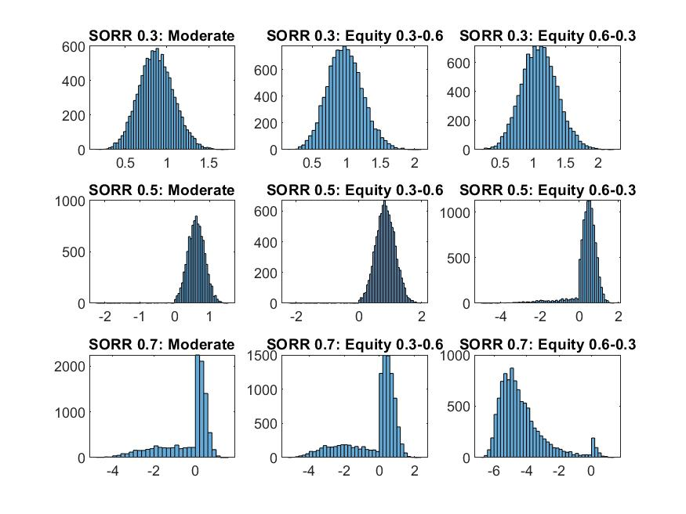
APPENDIX
When initial withdraw = $30,000

Slide 37
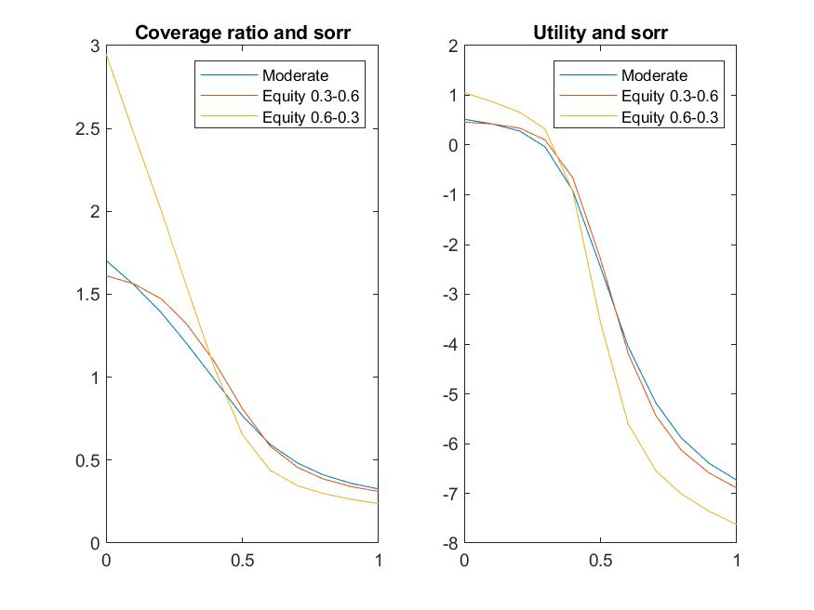
APPENDIX
When initial withdraw = $50,000

Slide 38
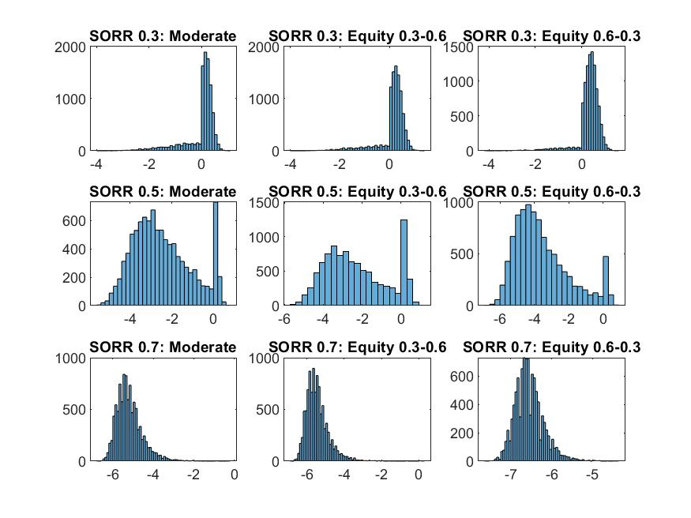
APPENDIX
When initial withdraw = $50,000

